Slide 1




MICROPROCESSOR
KCS 403
UNIT -IV
TOPIC:
Assembly Language Programming based on 8085
Jyoti Guglani
Department of Computer Science & Engineering
IMS ENGINEERING COLLEGE
Dr. A.P.J. Abdul Kalam Technical University,
Lucknow

Slide 2
Assembly Language Programming Based on 8085/86
Instructions, data transfer, arithmetic, logic
branch operations, looping
counting, indexing
programming techniques
counters and time delays
stacks and subroutines
conditional call and return instruction

Slide 3
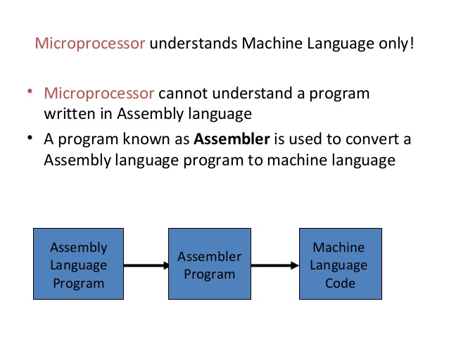

Slide 4
Writing Assembly Language Program
Analyze the problem
Develop program logic
Write an algorithm
Write Program Instructions of Microprocessor.

Slide 5
Program to Add two numbers in 8085
Problem – Write an assembly language program to sum two 8 bit numbers without using carry operation in 8085 microprocessor.
Analyze and Develop Problem logic –
The Starting Address of program and the memory locations of two input numbers with result memory location are to be assumed.
Assumption;
The starting address of the program is 2000.
Memory address of the first number is 2050.
(For 8 bit number only one memory location required)
Memory address of the second number is 2051.
(For 8 bit number only one memory location required)
Memory address of result is 2052.

Slide 6
Algorithm to Add two numbers in 8085
Load the first number to the accumulator through memory address 2050.
Move the content of accumulator to the register B.
Load the second number to the accumulator through memory address 2051.
Add the content of accumulator and register B and result will be stored at the accumulator.
Store the result from the accumulator to the memory address 2052.
Terminate the program.

Slide 7
Program to Add two numbers in 8085
Memory Address | Mnemonics | Comment
2000 | LDA 2050 | Load A with data of location 2050
2003 | MOV B, A | Copy data from A to B
2004 | LDA 2051 | Load A with data of location 2051
2007 | ADD B | A= A + B
2008 | STA 2052 | Copy data of A in location 2052
200B | HLT | Terminate/Stop

Slide 8
Explanation
LDA 2050: This instruction will load the number from memory to the accumulator.
MOV B, A: This instruction will move the content of accumulator to the register B.
LDA 2051: This instruction will load the number from memory to the accumulator.
ADD B: This instruction will sum the content of the accumulator with the content of the register B.
STA 2052: This instruction will store the content of accumulator to the memory address 2052.
HLT: This instruction will terminate the program.

Slide 9
Program to Subtract two numbers in 8085
Problem – Write an assembly language program to subtract two 8 bit numbers in 8085 microprocessor.
Analyze and Develop Problem logic –
The Starting Address of program and the memory locations of two input numbers with result memory location are to be assumed.
Assumption;
The starting address of the program is 2000.
Memory address of the first number is 2050.
(For 8 bit number only one memory location required)
Memory address of the second number is 2051.
(For 8 bit number only one memory location required)
Memory address of result is 2052.

Slide 10
Algorithm to Subtract two numbers in 8085
Load the first number to the accumulator through memory address 2050.
Move the content of accumulator to the register B.
Load the second number to the accumulator through memory address 2051.
Subtract the content of accumulator and register B and result will be stored at the accumulator.
Store the result from the accumulator to the memory address 2052.
Terminate the program.

Slide 11
Program to Subtract two numbers in 8085
Memory Address | Mnemonics | Comment
2000 | LDA 2050 | Load A with data of location 2050
2003 | MOV B, A | Copy data from A to B
2004 | LDA 2051 | Load A with data of location 2051
2007 | SUB B | A= A - B
2008 | STA 2052 | Copy data of A in location 2052
200B | HLT | Terminate/Stop

Slide 12
Program to Increment a numbers in 8085
Memory Address | Mnemonics | Comment
2000 | LDA 2050 | Load A with data of location 2050
 | INR A | A= A + 1
 | STA 2051 | Copy data of A in location 2051
 | HLT | Terminate/Stop

Slide 13
Program to Decrement a numbers in 8085
Memory Address | Mnemonics | Comment
2000 | LDA 2050 | Load A with data of location 2050
 | DCR A | A= A + 1
 | STA 2051 | Copy data of A in location 2051
 | HLT | Terminate/Stop

Slide 14
Program to Subtract two numbers using registers
Memory Address | Mnemonics | Comment
2000 | MVI A 96 | Load A with data 96 H
 | MVI E 38 | Load E with 38 H
 | SUB E | Subtract content of register E with A
 | HLT | Terminate/Stop

Slide 15
Program to ADD two numbers with Immediate addressing
Memory Address | Mnemonics | Comment
2000 | MVI A 97h | Load A with data 97 H
 | ADI 24h | Add 97 with 24 with Carry
 | HLT | Terminate/Stop

Slide 16
Program to Subtract two numbers with immediate addressing
Memory Address | Mnemonics | Comment
2000 | MVI A 97h | Load A with data 97 H
 | SBI 24h | Add 97 with 24 with Carry
 | HLT | Terminate/Stop

Slide 17
Program for LOGIC OR
MVI A C6h 1100 0110
ORI 39h 0011 1001
HLT 1111 1111

Slide 18
Program for LOGIC AND
MVI A C6h
ANA 39h
HLT

Slide 19
Program for X OR Logic
MVI A BCh 1011 1100
XRI 87h 1000 0111
HLT 0011 1011

Slide 20
Program XOR Logic
MVI A 12h
XRA A
HLT

Slide 21
MULTIPLICATION OF TWO NUMBERS
LDA 2000h
MOV E A
MVI D 00h
LDA 2001h
MOV C A
LXI H 0000h
LOOP: DAD D
DCR C
JNZ LOOP
SHLD 2002h
HLT

Slide 22
ADDITION OF TWO BCD NUMBERS
LDA 2050h
MOV B A
LDA 2051h
ADD B
DAA
STA 2052h
HLT

Slide 23
1’s and 2’s complement of 8 bit number in 8085
LDA 2050h
CMA
STA 2051
INR A
STA 2052
HLT

Slide 24
1’s and 2’s complement of 16 bit number in 8085
LHLD [2050]
MOV A L
CMA
MOV L A
MOV A H
CMA
MOV H A
SHLD [2052]
INX H
SHLD [2054]
HLT

Slide 25
THANK YOU
STUDENTS
Be Safe and Stay at home

